Slide 1
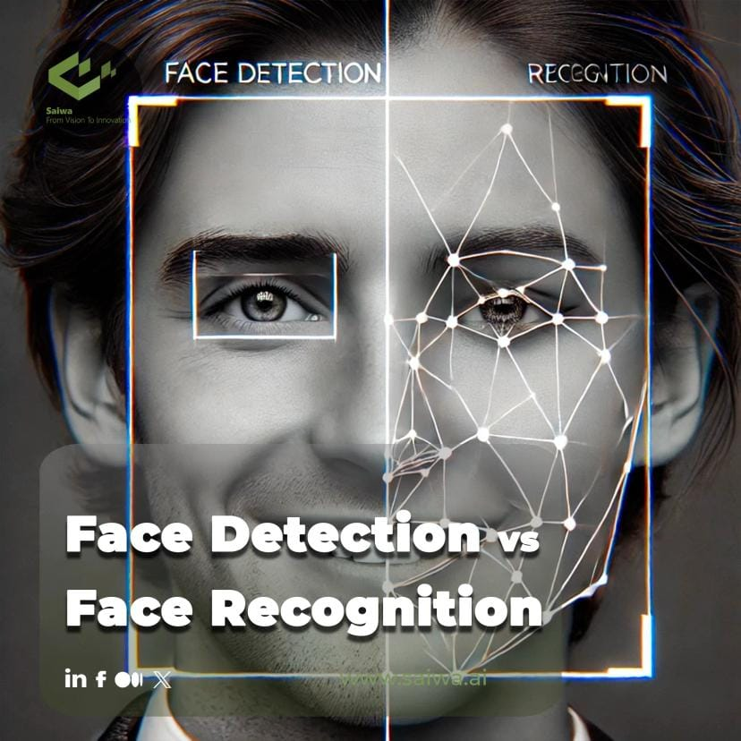
Face Recognition Attendance System

Slide 2
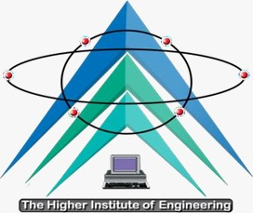

El-Shorouk Academy The Higher Institute of Engineering Communications & Computer engineering department
PREPARED BY:
Mohamed Amr Ahmed.
Mariam Ahmed Abd El-Hady.
Weam Osama Mohamed.
Mohamed Salah El-Din Abdel Qader.
Omar Mohamed El-Sayed.
Mohamed Abdel Baky El-Sayed.
UNDER-SUPERVISION:
Dr/ Sahar Kamal.
Eng/ Amira El-Sayed.
`

Slide 3
Table of contents
1- Introduction
2-problem statement and objective
3- Project Flow Diagram
4-Related Work
5- Face Detection
6- Face Recognition
7- Database
8- Applications
9- Conclusion
10- References
11-Future Work
12- Time plan
5.1- Definition and work technic.
5.2- Techniques Methods in Faces Detection.
5.3- YOLO algorithm and benefits of using it.
5.4- YOLOv11compared with other versions.
5.5- YOLO11 Architecture.
5.6- Results.
6.1- Definition.
6.2-Face Recognition History.
6.3- Comparison between different algorithms.
6.4- FaceNet Algorithm.
6.5- FaceNet Architecture.

Slide 4
Introduction
Attendance monitoring is essential in educational and corporate settings to track presence and punctuality. Traditional methods like manual sign-in or ID card swipes can be time-consuming and error-prone. With advances in technology, facial recognition systems now offer a more efficient solution by automatically recording attendance based on individuals' facial features.

Slide 5
Table of contents
1- Introduction
2-problem statement and objective
3- Project Flow Diagram
4-Related Work
5- Face Detection
6- Face Recognition
7- Database
8- Applications
9- Conclusion
10- References
11-Future Work
12- Time plan
5.1- Definition and work technic.
5.2- Techniques Methods in Faces Detection.
5.3- YOLO algorithm and benefits of using it.
5.4- YOLOv11compared with other versions.
5.5- YOLO11 Architecture.
5.6- Results.
6.1- Definition.
6.2-Face Recognition History.
6.3- Comparison between different algorithms.
6.4- FaceNet Algorithm.
6.5- FaceNet Architecture.

Slide 6
Problem statement and objective
In a classroom with large number of students, it is a very tedious and time consuming task to take the attendance manually. Therefore we can implement an effective system which will mark the attendance of students automatically by recognizing their faces.

Slide 7
Table of contents
1- Introduction
2-problem statement and objective
3- Project Flow Diagram
4-Related Work
5- Face Detection
6- Face Recognition
7- Database
8- Applications
9- Conclusion
10- References
11-Future Work
12- Time plan
5.1- Definition and work technic.
5.2- Techniques Methods in Faces Detection.
5.3- YOLO algorithm and benefits of using it.
5.4- YOLOv11compared with other versions.
5.5- YOLO11 Architecture.
5.6- Results.
6.1- Definition.
6.2-Face Recognition History.
6.3- Comparison between different algorithms.
6.4- FaceNet Algorithm.
6.5- FaceNet Architecture.

Slide 8
Project Flow Diagram
Integration
Foundation
Remember: to not take your assessment work seriously is to completely underserve your students. Assessment is absolutely vital to learning and is a core component of the “plan-instruct-assess-learn” cycle.
...
Survey
Desktop & Mobile Design
Once you begin to move past the “Not Yet” level, you’re getting into the “Getting There!” zone. Getting There is where you start to see the seeds of learning take root and start to manifest themselves in your students behaviours.
With all of that evidence laid out in front of me, I’m going to take a global view of it all and determine the three student indicators that I think will best represent mastery of this grade-level outcome.
Final System Production
Design & Establishment
Framework & API
The “Got It!” level is where you start to see those new behaviours being demonstrated on a consistent basis. The student understands what they are doing and are doing it intentionally in class.
I’ve identified by asking myself “what are the skills, knowledge, and understandings a student would need to demonstrate in order to show me that they’ve mastered this content”.
ERD & Schema
DB Implementation
That’s why the Learning Roadmaps always have a “Wow!” stretch level. This milestone represents what learning would look like if the student went above and beyond what was expected of them at their grade-level.
Aside from wanting to assess skill, knowledge and understanding, there is another reason why I make sure that I also select three student indicators per outcome that I am assessing and it has to do with how I grade my students in physical education.
AI
- Face Detection Research - Model Training - Face Recognition Research - Model training

Slide 9
Table of contents
1- Introduction
2-problem statement and objective
3- Project Flow Diagram
4-Related Work
5- Face Detection
6- Face Recognition
7- Database
8- Applications
9- Conclusion
10- References
11-Future Work
12- Time plan
5.1- Definition and work technic.
5.2- Techniques Methods in Faces Detection.
5.3- YOLO algorithm and benefits of using it.
5.4- YOLOv11compared with other versions.
5.5- YOLO11 Architecture.
5.6- Results.
6.1- Definition.
6.2-Face Recognition History.
6.3- Comparison between different algorithms.
6.4- FaceNet Algorithm.
6.5- FaceNet Architecture.

Slide 10
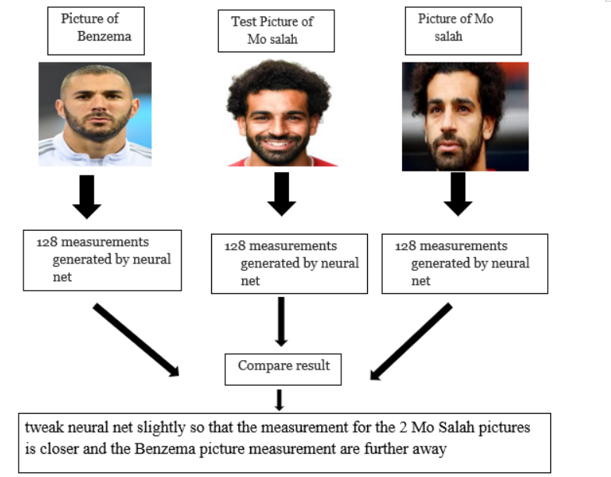
Related Work
In 2022 Graduation Project:
The system was created based on mobile application to follow employee’s attendance with it and compares between the photo of the person in the database and the person who standup in front of the camera.
At the same time, it takes the temperature with the temperature detection device. In case the photo and the person match, the system will take his attendance, And from the application you can track your attendance.

Slide 11
Table of contents
1- Introduction
2-problem statement and objective
3- Project Flow Diagram
4-Related Work
5- Face Detection
6- Face Recognition
7- Database
8- Applications
9- Conclusion
10- References
11-Future Work
12- Time plan
5.1- Definition and work technic.
5.2- Techniques Methods in Faces Detection.
5.3- YOLO algorithm and benefits of using it.
5.4- YOLOv11compared with other versions.
5.5- YOLO11 Architecture.
5.6- Results.
6.1- Definition.
6.2-Face Recognition History.
6.3- Comparison between different algorithms.
6.4- FaceNet Algorithm.
6.5- FaceNet Architecture.

Slide 12
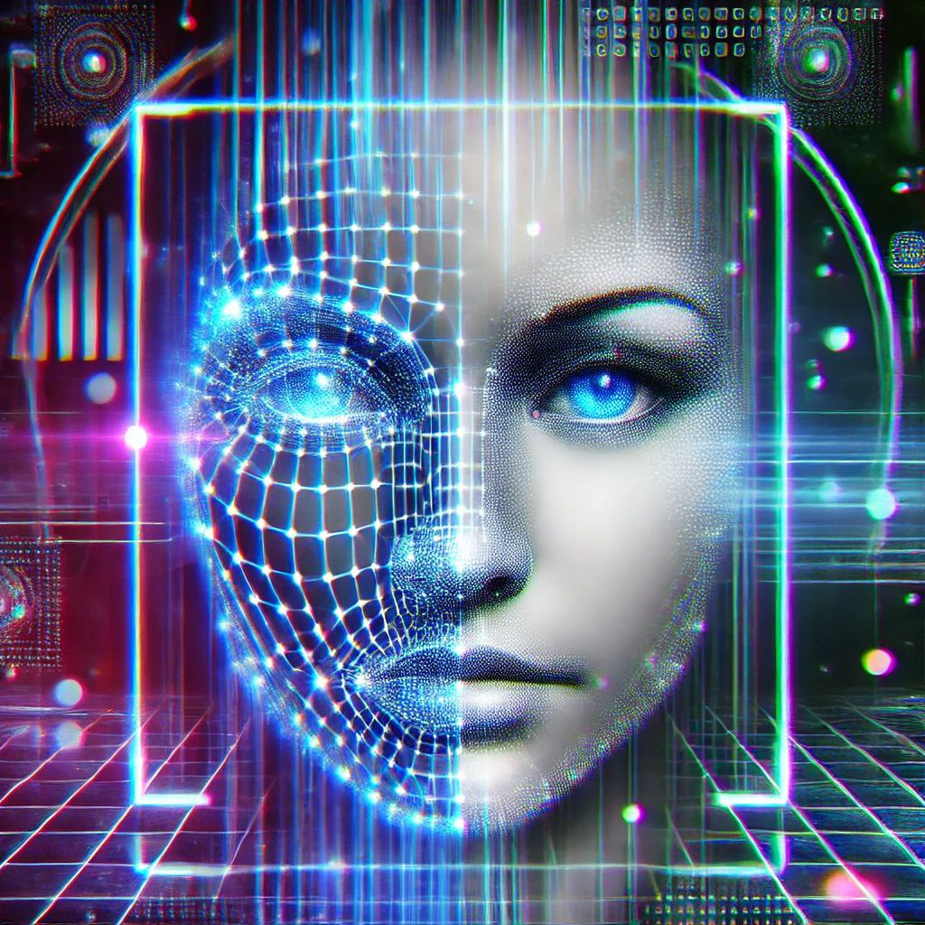
Face
Detection

Slide 13
Face Detection
Definition :
Face detection is a computer technology being used in a variety of applications that identifies human faces in digital images. Face detection also refers to the psychological process by which humans locate and attend to faces in a visual scene.
Work technic :
Algorithms: Analyze facial features such as eyes, nose, and mouth.
Feature Identification: Detects key landmarks like eyebrows, nose, and lips.
Training: Uses large datasets to ensure accuracy and adaptability in different conditions.

Slide 14
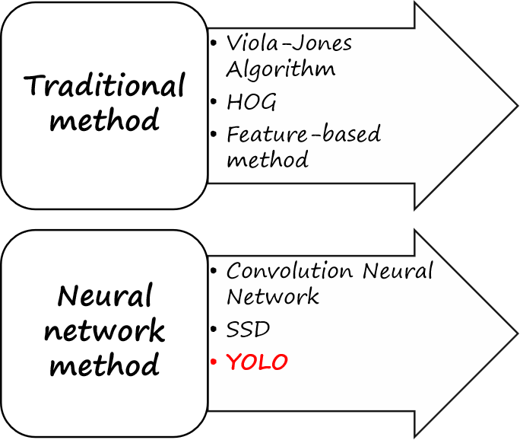
Techniques Methods in Face Detection :
Face detection techniques have evolved over the years to achieve more accurate results.
Techniques are broadly divided into:
Traditional methods.
Neural network-based methods

Slide 15
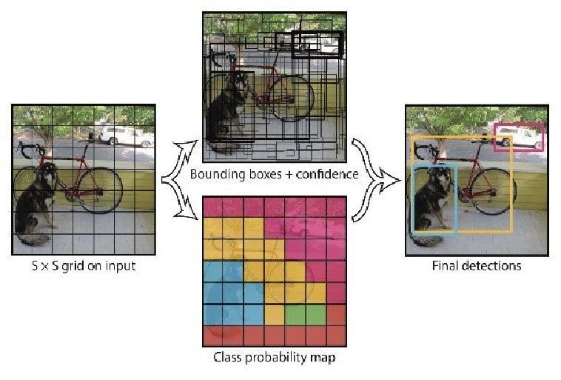
YOLO Algorithm
YOLO stands for "You Only Look Once," a popular real-time object detection algorithm.
YOLO detects faces by dividing an image into a grid, each grid part predicting objects and their locations.
It combines predictions to provide efficient and accurate face detection

Slide 16
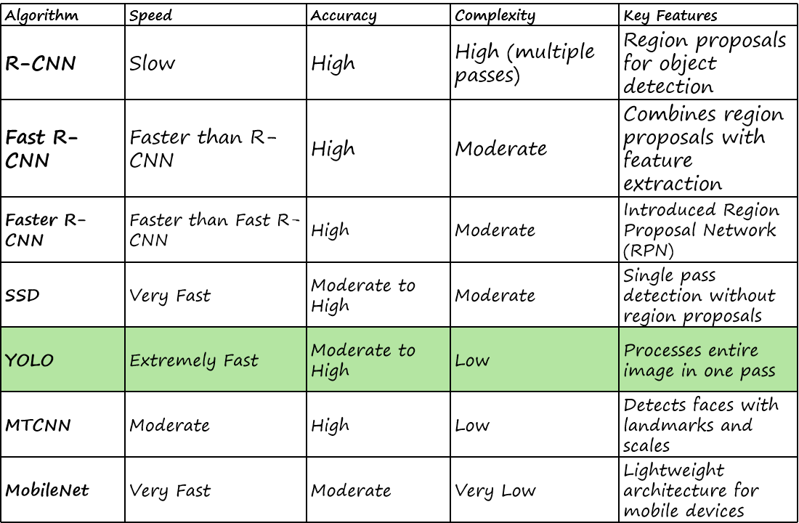
The comparison between different algorithms of Face Detection

Slide 17
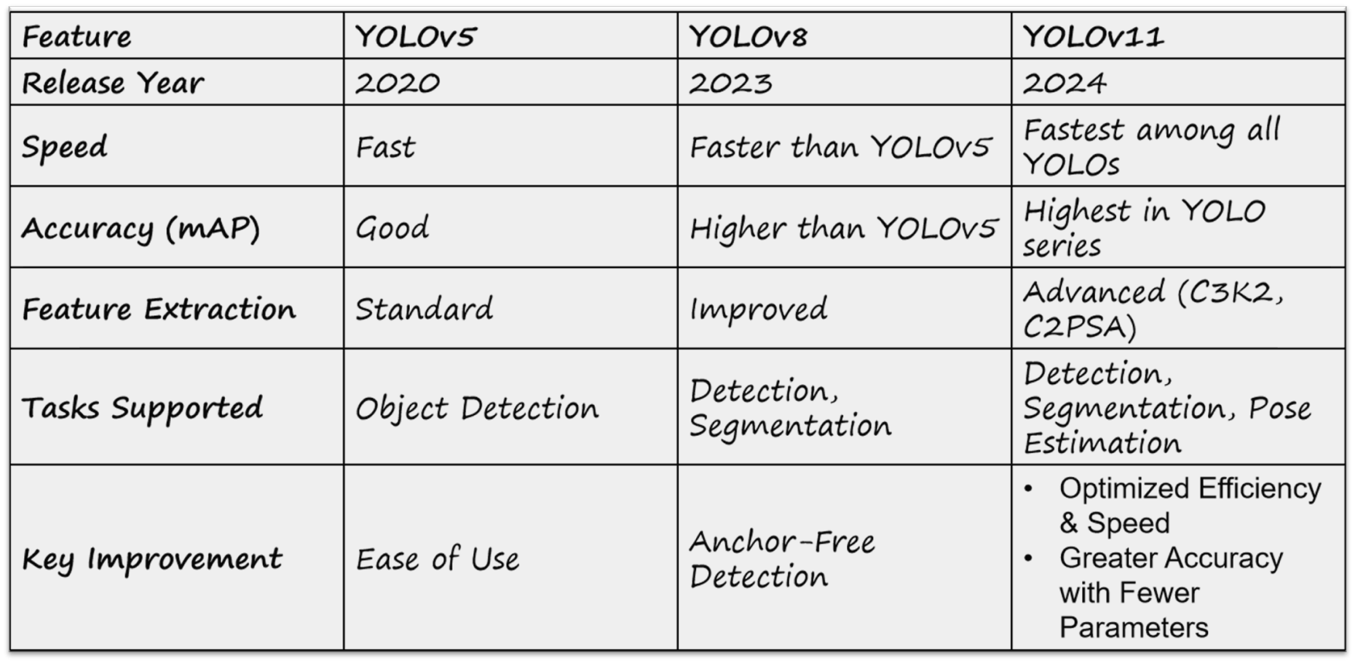
The benefits of using version ( YOLOv11) (YOLOv11 is the latest version in the YOLO series, offering significant enhancements and improvements over previous versions.)

Slide 18
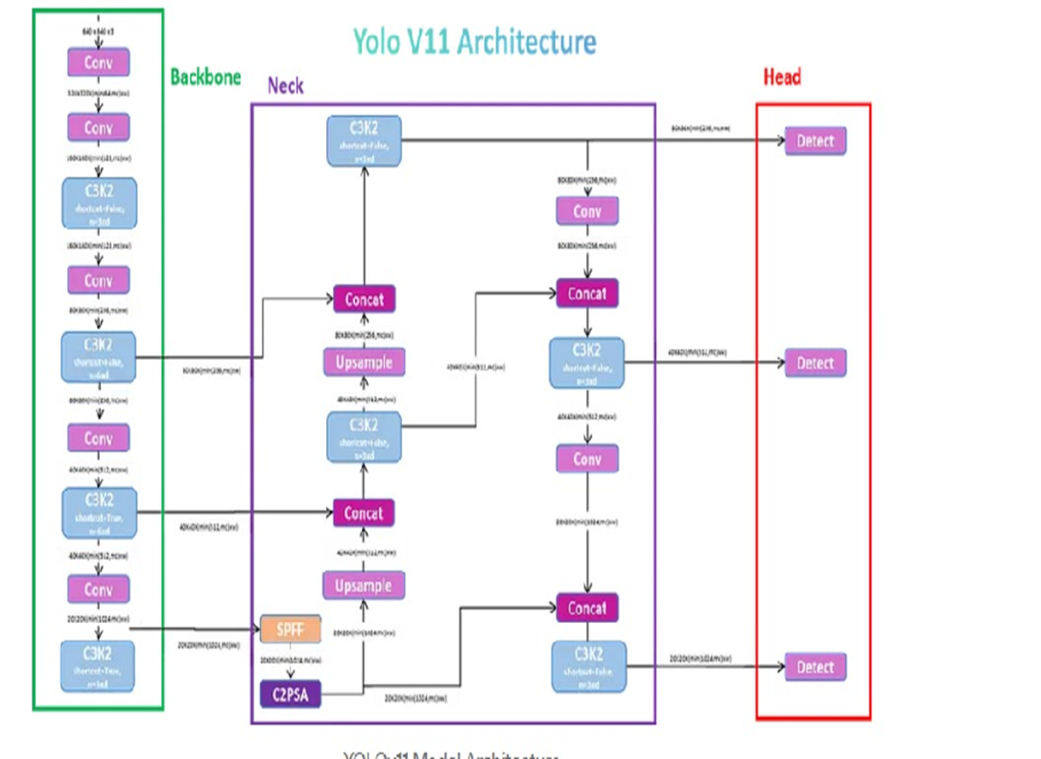
YOLO11 Architecture
The architecture consists of three main components:
Backbone: Uses the C3K2 block for feature extraction, capturing essential patterns for accurate detection
Neck : Utilizes the SPPF module to refine and aggregate features, improving detection at various scales.
Head: Employs the C2PSA block for spatial attention, generating bounding boxes, class labels, and confidence scores.

Slide 19
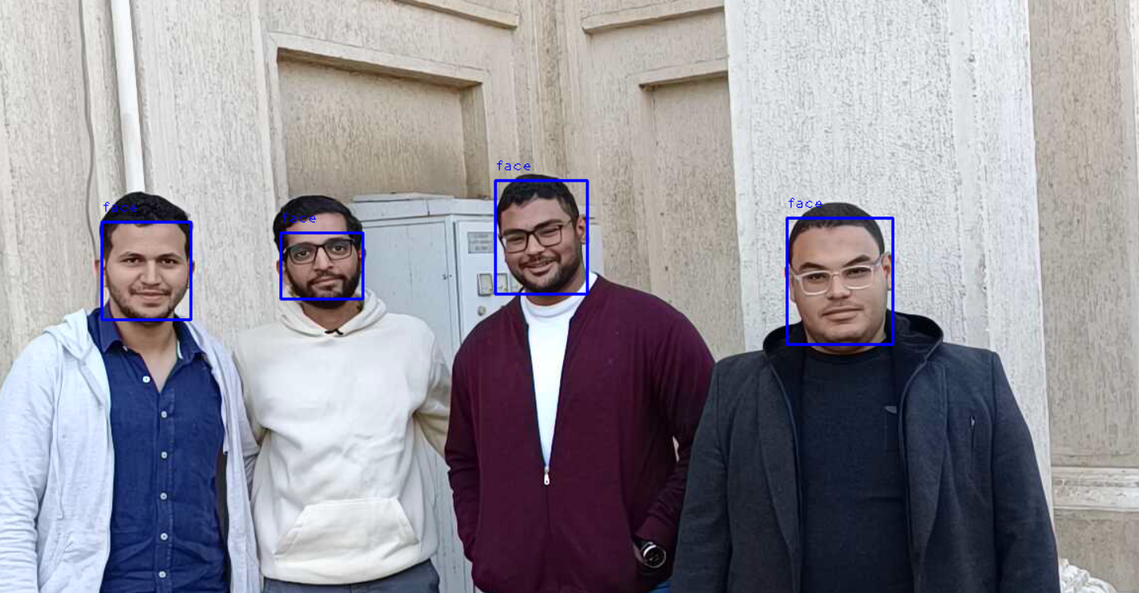
Results

Slide 20
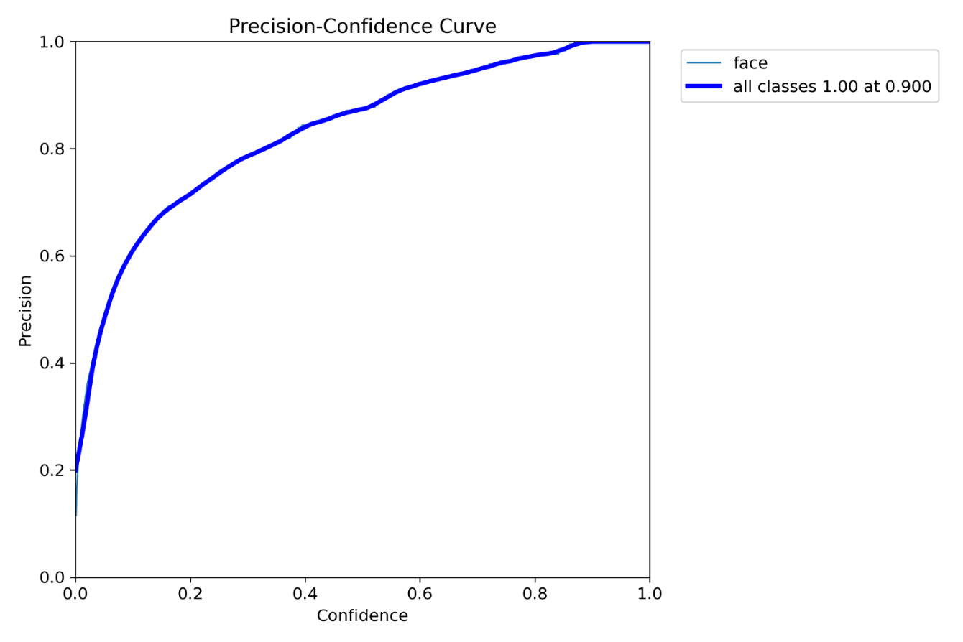
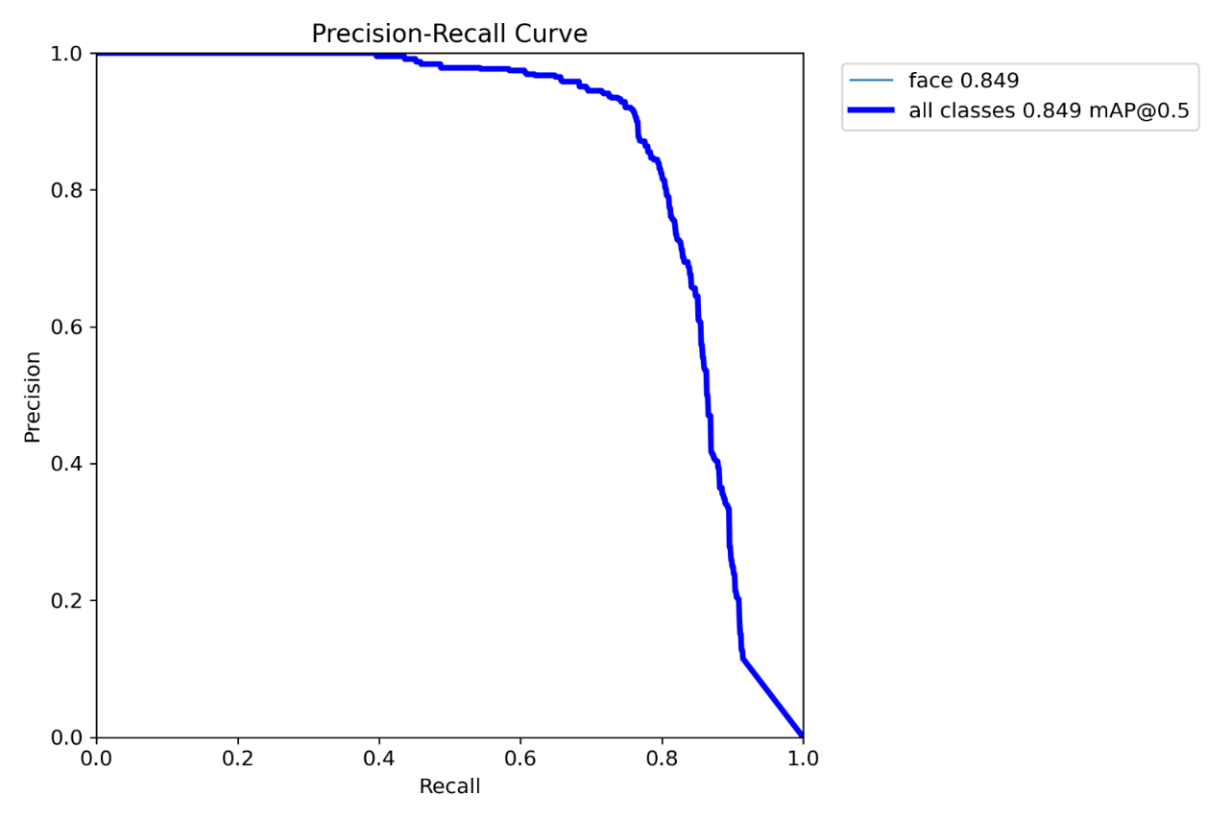
Results

Slide 21
Table of contents
1- Introduction
2-problem statement and objective
3- Project Flow Diagram
4-Related Work
5- Face Detection
6- Face Recognition
7- Database
8- Applications
9- Conclusion
10- References
11-Future Work
12- Time plan
5.1- Definition and work technic.
5.2- Techniques Methods in Faces Detection.
5.3- YOLO algorithm and benefits of using it.
5.4- YOLOv11compared with other versions.
5.5- YOLO11 Architecture.
5.6- Results.
6.1- Definition.
6.2-Face Recognition History.
6.3- Comparison between different algorithms.
6.4- FaceNet Algorithm.
6.5- FaceNet Architecture.

Slide 22
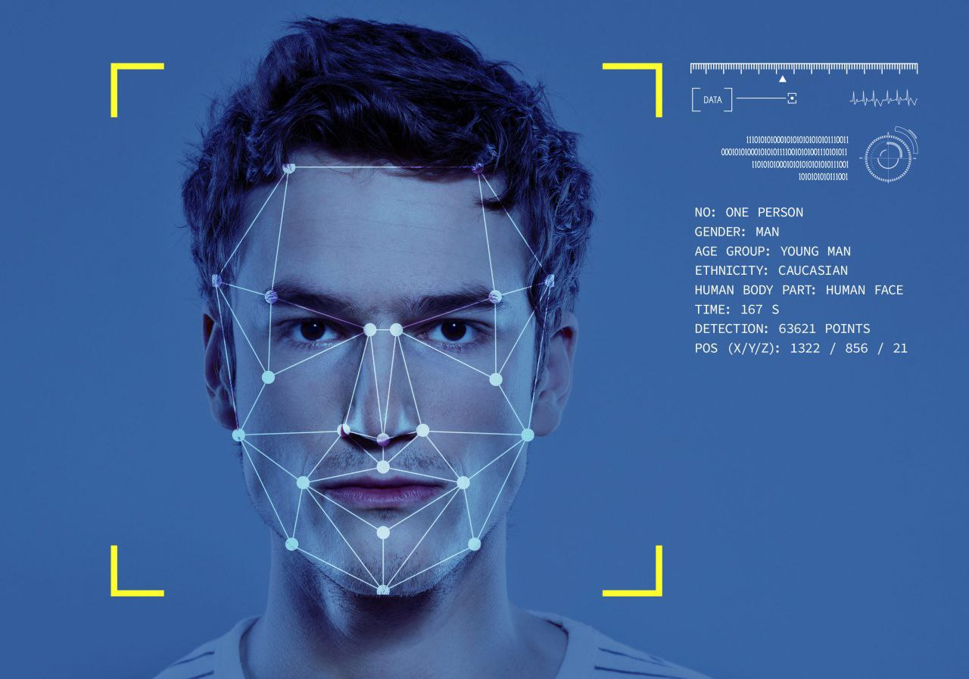
Face
Recognition

Slide 23
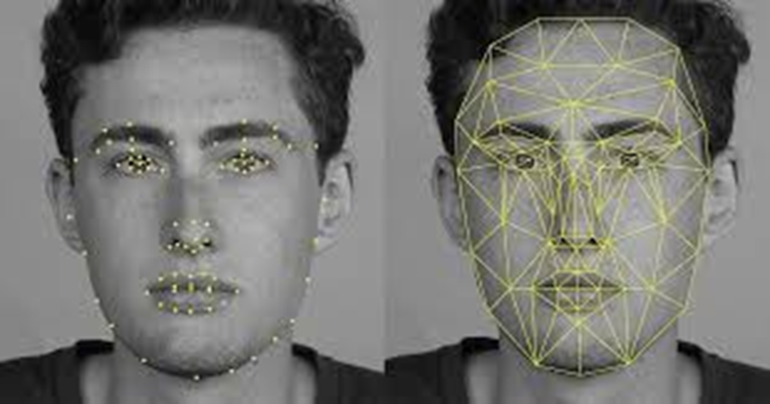
Definition: Face Recognition : is the process of identifying or verifying a person’s identity using their facial features
Face Recognition

Slide 24
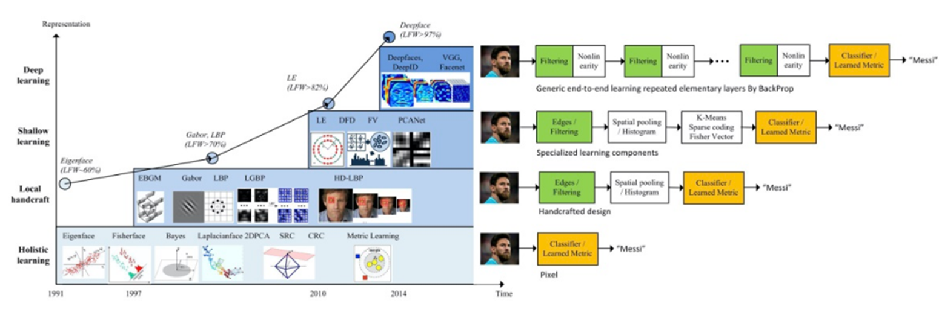
Face Recognition History
The concept of face recognition is not new, nor is its implementation. The evolution of face recognition is fascinating and using computers to recognize faces has been dated back to the 1960’s.
year 2014 was marked as an important year in the evolution of facial recognition as it reshaped the research landscape of this technology. It was the year when Facebook’s DeepFace model’s accuracy (97.35%) on the LFW benchmark dataset approached human performance (97.53%) for the first time. Just three years after this breakthrough, the accuracy of face recognition reached 99.80%.

Slide 25
The comparison between different algorithms of Face Recognition
Algorithm | Key Features | Pros | Cons | Use Cases
Eigenfaces | Based on PCA (Principal Component Analysis) | Simple and fast | Sensitive to lighting and pose changes | Early face recognition systems, small datasets
LBPH (Local Binary Pattern Histograms) | Uses texture-based features (local binary patterns) | Robust to lighting and pose changes | Limited accuracy for complex recognition tasks | Real-time face recognition, low-resolution images
Fisherfaces | Uses LDA (Linear Discriminant Analysis) to reduce dimensionality | Better at distinguishing between individuals | Still sensitive to variations in lighting | Small to medium-sized datasets
DeepFace | Uses deep neural networks (DNNs) for face verification | High accuracy, works well with large datasets | Requires large training data and high computational power | Social media platforms, large-scale face recognition
FaceNet | Generates 128-D embeddings using a triplet loss function | High accuracy, compact embedding representation | Requires large dataset, training can be complex | Face verification, face recognition systems

Slide 26
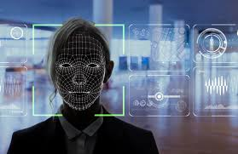
FaceNet
FaceNet is a deep learning model developed by Google for face recognition, verification, and clustering.

Slide 27
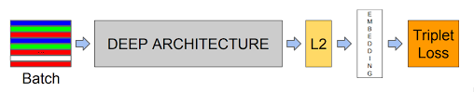
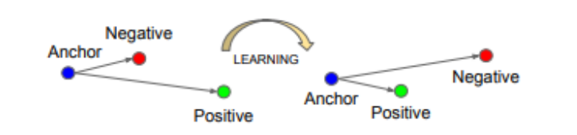
FaceNet Architecture (end-to-end learning)
In end-to-end learning, the model learns directly from raw input to output (in this case, from the image batch to embeddings) without the need for manual feature extraction steps, making it an "end-to-end" process.
Our network consists of a batch input layer and a deep CNN followed by L2 normalization, which results in the face embedding. This is followed by the triplet loss during training.

Slide 28
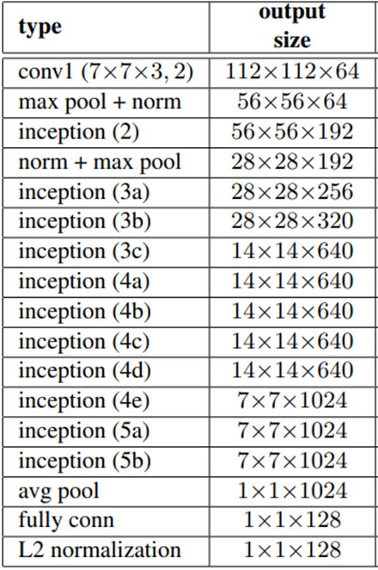
Deep Architecture Layers
1- Convolutional Layers(The foundation of the deep architecture):
These layers apply filters (small matrices) to the input image, which allows the network to learn various features like edges, textures, and more complex structures such as eyes, noses, and mouths.
2- Inception Modules(Inception-ResNet):
Inception modules are unique because they apply multiple filters of different sizes (1x1, 3x3, 5x5) at the same time.
This parallel structure allows the network to process information efficiently and effectively capture the hierarchical features of faces.
3- Pooling Layers(Max pooling):
Max pooling is the most common method, which keeps the most prominent features by selecting the maximum value from small regions of the feature map.
This reduces the computational complexity and helps the network focus on the most important facial features.

Slide 29
Deep Architecture Layers Cont.
4- Batch Normalization and Activation Functions
Batch Normalization: is applied to stabilize and speed up training by normalizing the input to each layer.
Activation Functions (ReLU Activation Functions):
ReLU (Rectified Linear Unit): is used as the activation function to introduce non-linearity into the model. This allows the network to learn more complex features.
5- Fully Connected (Dense) Layers:
After passing through several convolutional and pooling layers, the feature maps are flattened into a one-dimensional vector.
This vector is then fed into fully connected layers, where the network learns the high-level combinations of the facial features extracted by the previous layers .
These fully connected layers further condense the information into meaningful representations.

Slide 30
L2 Normalization
L2 normalization: is a mathematical technique used to scale vectors so that their magnitudes (lengths) become 1.
Ensures embeddings have unit length: All embeddings are scaled to lie on the unit hypersphere.
Focuses on direction: After normalization, comparisons between embeddings focus only on the direction (i.e., similarity) rather than magnitude.
Enables effective distance comparison: Normalized embeddings allow reliable comparison using Euclidean distance or cosine similarity, making face recognition more accurate.

Slide 31
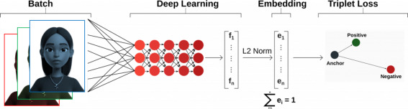
Embedding
Embedding : is a low-dimensional, continuous vector representation of data (in this case, faces).
The idea is to encode complex data (like a face) into a compact format (128 values) that can still capture the unique features necessary to distinguish one face from another. These 128-dimensional vectors allow efficient face recognition and verification.

Slide 32
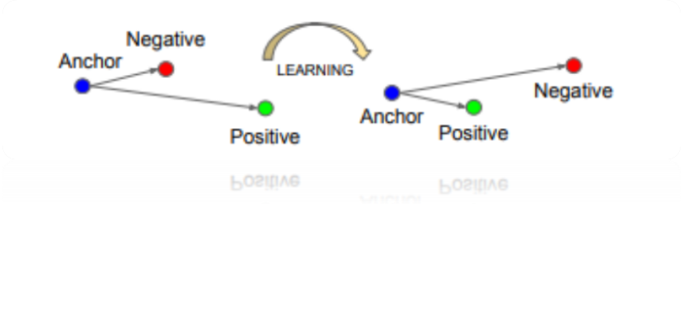
Triplet Loss Function
The Triplet Loss function: optimizes the FaceNet model by comparing three embeddings at a time, known as a triplet.
Each triplet consists of three images:
1-Anchor (A): The reference image.
2-Positive (P): Another image of the same person as the anchor.
3-Negative (N): An image of a different person from the anchor.
Minimize the distance between the anchor and positive embeddings while maximizing the distance between the anchor and negative embeddings.

Slide 33
Table of contents
1- Introduction
2-problem statement and objective
3- Project Flow Diagram
4-Related Work
5- Face Detection
6- Face Recognition
7- Database
8- Applications
9- Conclusion
10- References
11-Future Work
12- Time plan
5.1- Definition and work technic.
5.2- Techniques Methods in Faces Detection.
5.3- YOLO algorithm and benefits of using it.
5.4- YOLOv11compared with other versions.
5.5- YOLO11 Architecture.
5.6- Results.
6.1- Definition.
6.2-Face Recognition History.
6.3- Comparison between different algorithms.
6.4- FaceNet Algorithm.
6.5- FaceNet Architecture.

Slide 34
yearOfStudy
sub_Schedule
sub_ID
sub_Name
sub_Type
sub_AttendanceRatio
sub_Place
Database
M
Subject
about
Has
Has
M
1
M
M
f_ID
attend at
Feedback
sub_ID
M
f_rating
f_fdate
p_ID
f_cmnt
1
s_ID
Place
p_Name
1
1
s_PhoneNo
M
M
s_faceID
give
s_Specialization
M
Instructor
s_email
Student
M
Teaches
s_RegNo
s_ID
1
M
s_Name
1
login
1
s_Age
i_ID
i_PhoneNo
i_Gender
i_Specialization
i_email
i_Age
i_voicePrnt
i_Name
s_Gender
in
user_ID
s_SecID
yearOfStudy
n_sentdate
1
user_ID
M
Notification
n_status
Specialization
user_Role
msg
user_identifier
1
n_ID
last_Login
UserAccount
M
get
M
AttendanceRecord
M
obtain
1
AttendanceSummary
user_Pass
1
spec_Name
spec_description
spec_ID
user_Status
r_ID
is
attend_ID
s_ID
att_date
att_status
i_ID
sub_ID
1
sub_AttendenceRatio
attend_ID
sec_count
lec_count
RolesTable
User_id
r_ID
r_Name
permissions
r_description

Slide 35
Table of contents
1- Introduction
2-problem statement and objective
3- Project Flow Diagram
4-Related Work
5- Face Detection
6- Face Recognition
7- Database
8- Applications
9- Conclusion
10- References
11-Future Work
12- Time plan
5.1- Definition and work technic.
5.2- Techniques Methods in Faces Detection.
5.3- YOLO algorithm and benefits of using it.
5.4- YOLOv11compared with other versions.
5.5- YOLO11 Architecture.
5.6- Results.
6.1- Definition.
6.2-Face Recognition History.
6.3- Comparison between different algorithms.
6.4- FaceNet Algorithm.
6.5- FaceNet Architecture.

Slide 36
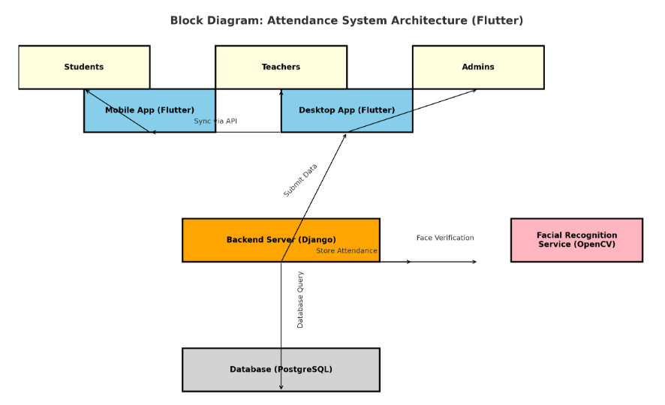
Applications
C4 Model - Context Diagram
1. Context Diagram (System Level)
Mobile Application:
Platform: Android/iOS.
Framework: Flutter.
2. Desktop Application:
Platform: Windows/Mac/Linux.
Framework: Flutter.
3. Framework: Django

Slide 37
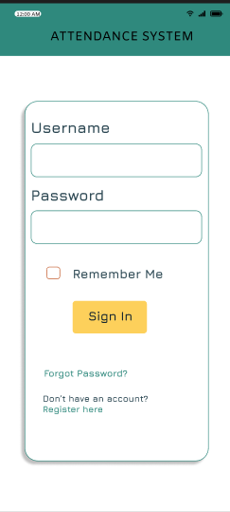
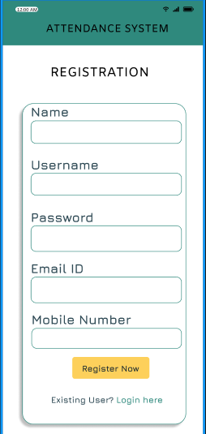
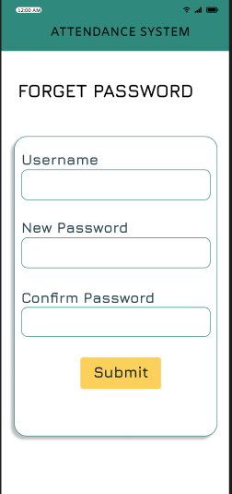
Mobile Application Design
User Authentication:
Registration Page
Login Page:
Forgot Password Page

Slide 38
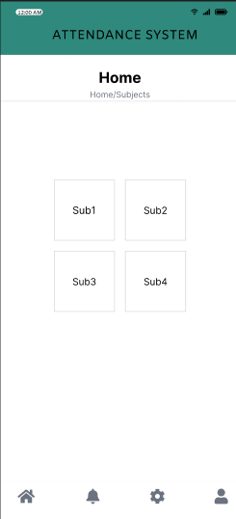
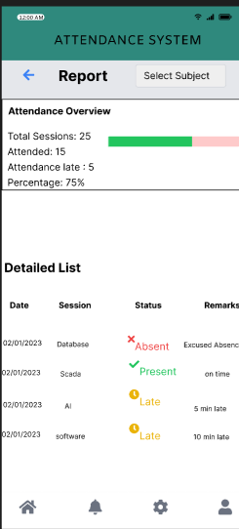
Attendance Recording
Reports

Slide 39
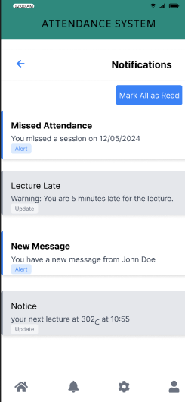
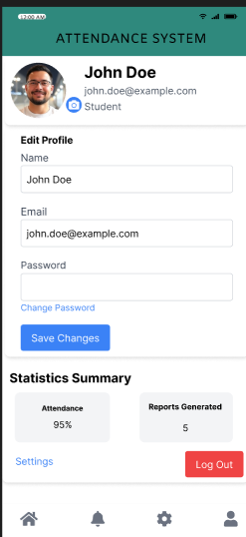
Notifications
Profile Page

Slide 40
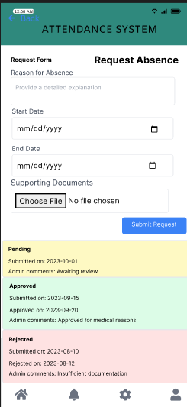
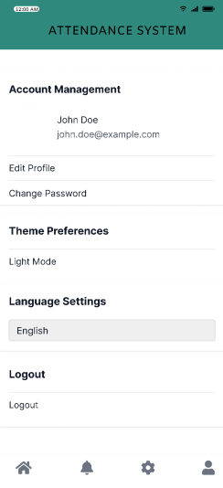
Request Absence Page
Settings Page

Slide 41
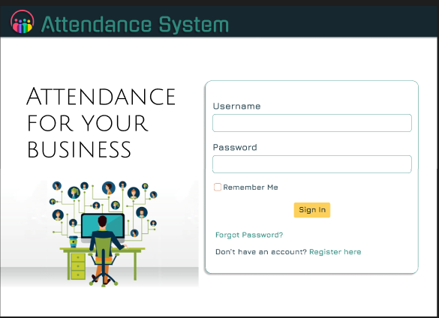
Desktop Application Design
Login Page

Slide 42
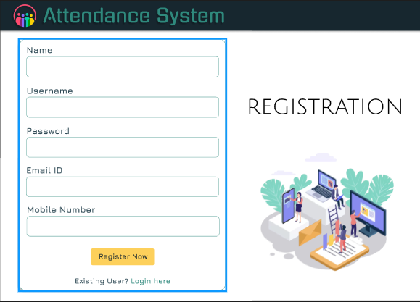
Registration Page

Slide 43
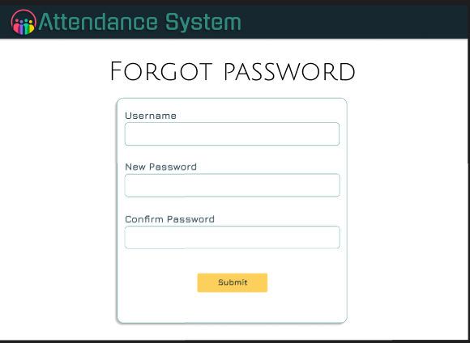
Forgot Password Page

Slide 44
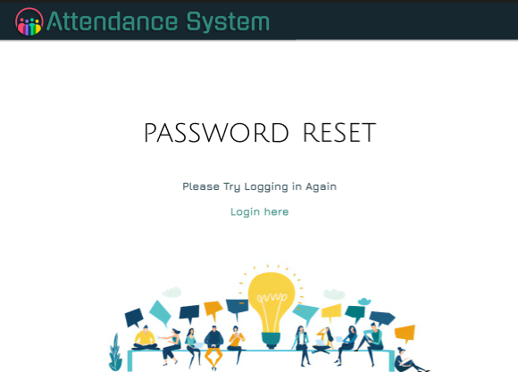
Password Reset Confirmation Page

Slide 45
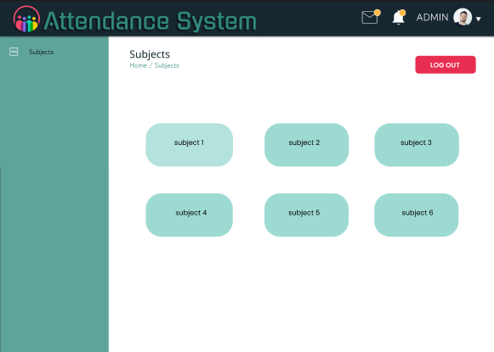
Subjects Page

Slide 46
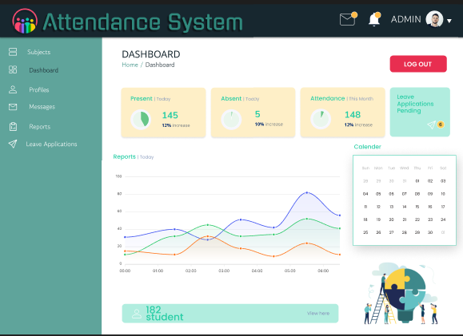
Dashboard Page.

Slide 47
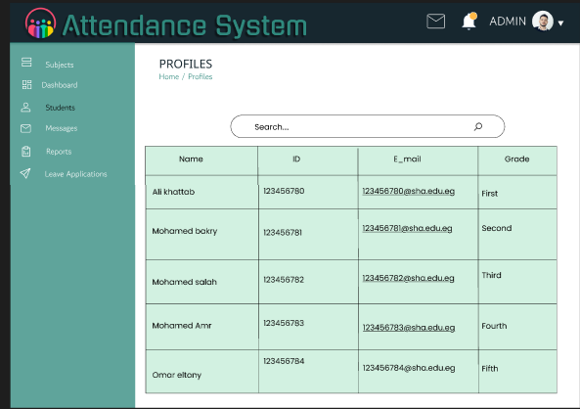
Profiles Page.

Slide 48
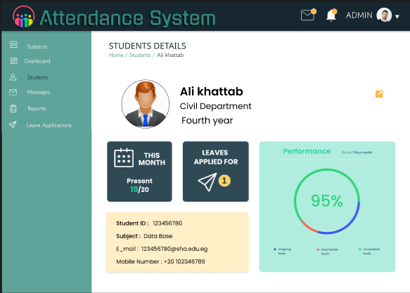
Student Details Page

Slide 49
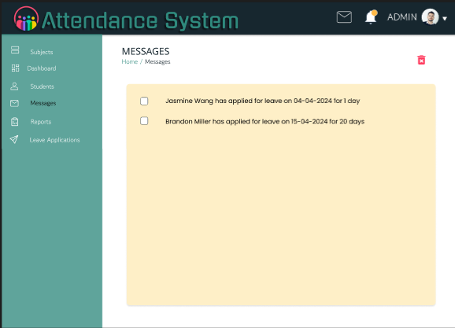
Messages Page

Slide 50
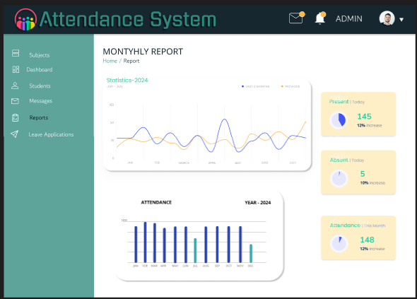
Monthly Reports Page

Slide 51
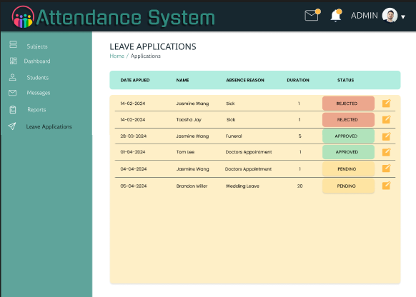
Leave Applications Page

Slide 52
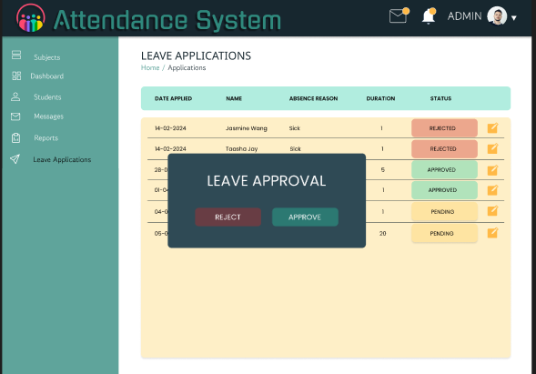

Slide 53
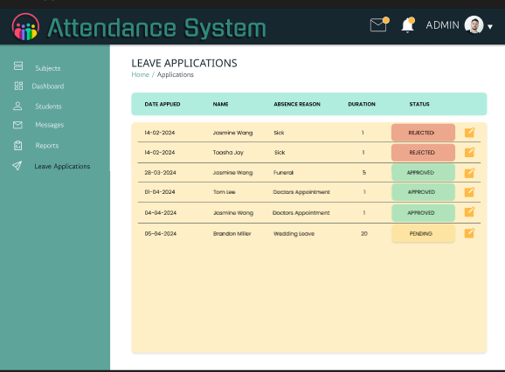

Slide 54
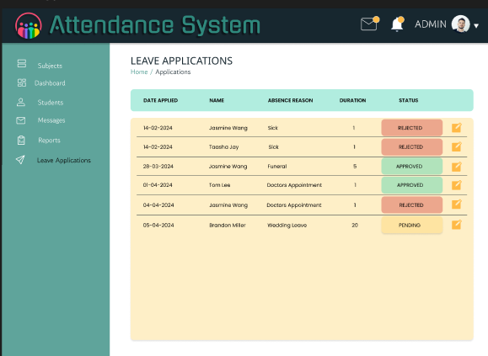

Slide 55
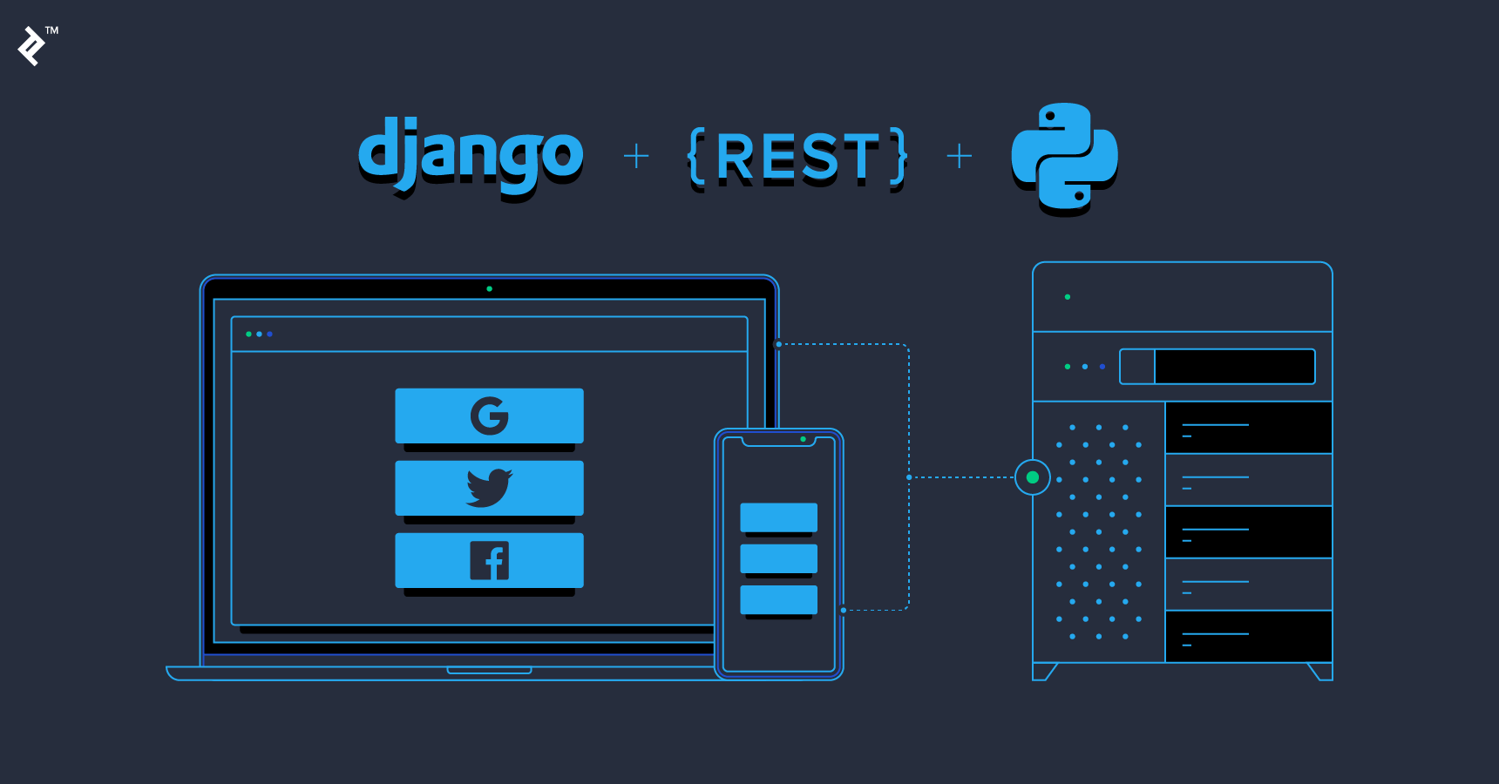
Back-end Platform and Framework
User Management:
Handles authentication, user roles (students, teachers, admins), and permissions.
Securely stores credentials and manages login/logout functionality.
API Development:
Using Django REST Framework (DRF), Django enables building RESTful APIs for mobile and desktop app communication.
These APIs will handle requests like submitting attendance data and retrieving reports.
Facial Recognition Integration:
The backend can interface with libraries like OpenCV or TensorFlow to process images sent from the mobile or desktop app.
Scalability:
Django's modular architecture allows it to scale as your user base grows.
Report Generation:
Provides tools to create attendance summaries and generate exportable reports (PDF/Excel).

Slide 56

Flutter
1. Single Codebase for Multiple Platforms:
Write code once and deploy it across mobile, web, and desktop platforms, saving time and reducing costs.
2. Rich UI/UX:
Flutter offers a vast collection of customizable widgets, enabling developers to create visually appealing and consistent UIs.
3. High Performance:
Since Flutter apps are compiled into native machine code, they achieve near-native performance on all platforms.
Flutter uses the Skia Graphics Engine, ensuring fast and smooth rendering.
4. Hot Reload:
Flutter's hot reload feature allows developers to see changes in the app instantly, speeding up development and debugging.
5. Active Community and Ecosystem:
With strong community support and growing adoption, Flutter has extensive documentation, plugins, and third-party packages available.

Slide 57
Table of contents
1- Introduction
2-problem statement and objective
3- Project Flow Diagram
4-Related Work
5- Face Detection
6- Face Recognition
7- Database
8- Applications
9- Conclusion
10- References
11-Future Work
12- Time plan
5.1- Definition and work technic.
5.2- Techniques Methods in Faces Detection.
5.3- YOLO algorithm and benefits of using it.
5.4- YOLOv11compared with other versions.
5.5- YOLO11 Architecture.
5.6- Results.
6.1- Definition.
6.2-Face Recognition History.
6.3- Comparison between different algorithms.
6.4- FaceNet Algorithm.
6.5- FaceNet Architecture.

Slide 58
Conclusion
The System will record the attendance of student using the facial recognition feature by using a camera installed inside the classroom to record attendance on the database and send an attendance report to the teacher. In addition, the student can follow up his attendance through an application on his mobile phone, and the teacher can follow up on attendance and absence reports through the Desktop application.

Slide 59
References
https://ieeexplore.ieee.org/xpl/conhome/8767138/proceeding
https://www.geeksforgeeks.org/yolo-you-only-look-once-real-time-object-detection/
Dang, Thai-Viet. (2023). Smart Attendance System based on Improved Facial Recognition. 4. 46-53. 10.18196/jrc.v4i1.16808.
https://www.techtarget.com/searchenterpriseai/definition/face-detection
https://learnopencv.com/yolo11/
https://arxiv.org/abs/2411.00201#:~:text=This%20study%20presents%20a%20comprehensive%20benchmark%20analysis%20of,YOLO11%2C%20the%20latest%20addition%20to%20the%20YOLO%20family
https://xailient.com/blog/how-has-face-recognition-advanced-since-the-1960s/
A Comparative Analysis of FaceNet, VGGFace, and GhostFaceNets Face Recognition Algorithms For Potential Criminal Suspect Identification.
https://doi.org/10.48185/jaai.v5i2.1237.
YOLOV11: AN OVERVIEW OF THE KEY ARCHITECTURAL ENHANCEMENTS.
System Design interview (Alex zu).

Slide 60
Future Work
1- Implementation of Face Recognition.
2- Implementation of applications.
3- Implementation of database.
4- Integration between AI Models, Database and applications.

Slide 61
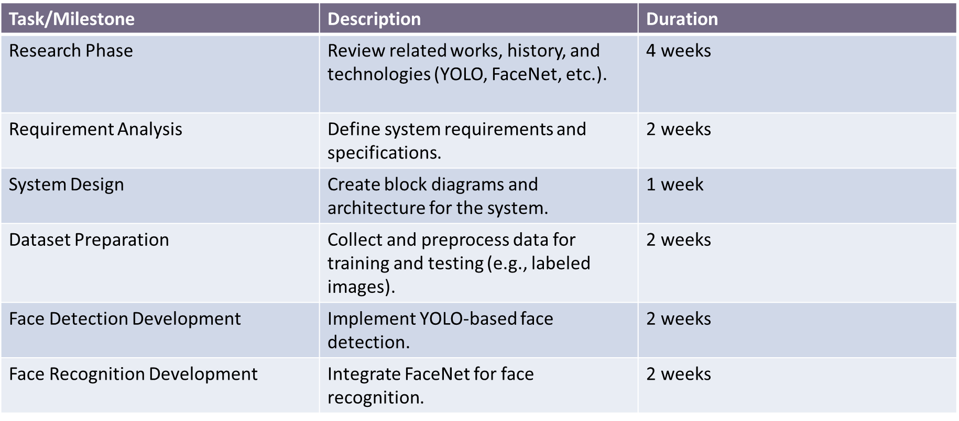
Project Time Plan

Slide 62
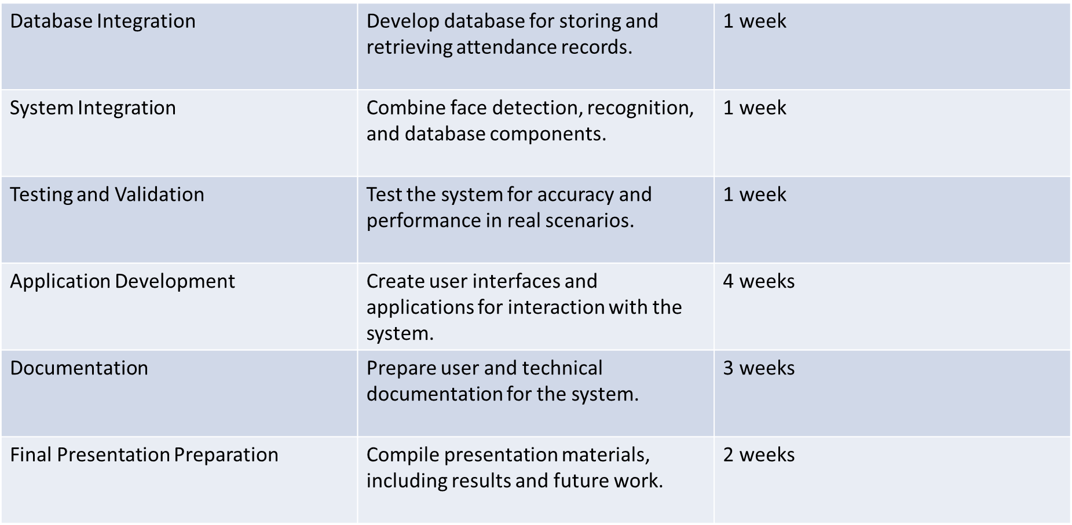
Project Time Plan

Slide 63
ANY
QUESTIONS?

